Slide 1
Descriptive Data Mining on New York City Bike Dataset
By:
Thilok Reddy Anugu, Sree Chandana Kurella and Vineela Velaga

Slide 2
Contents
Introduction to the DataSet
Association Mining – Apriori Algorithm
Implementation
Conclusion
References

Slide 3
Introduction
This dataset comprises details like Station Id, Longitude, Latitude, Start Time, Stop Time and Start and Stop Station Names.
The raw data has 1735599 rows and 15 columns
From the above data our focus is to
Find rules between In-flow and Out-flow of station 519.
Find rules between Time of a Day and Flows of station 519.
Find rules between Station Locations and their Daily flow.

Slide 4

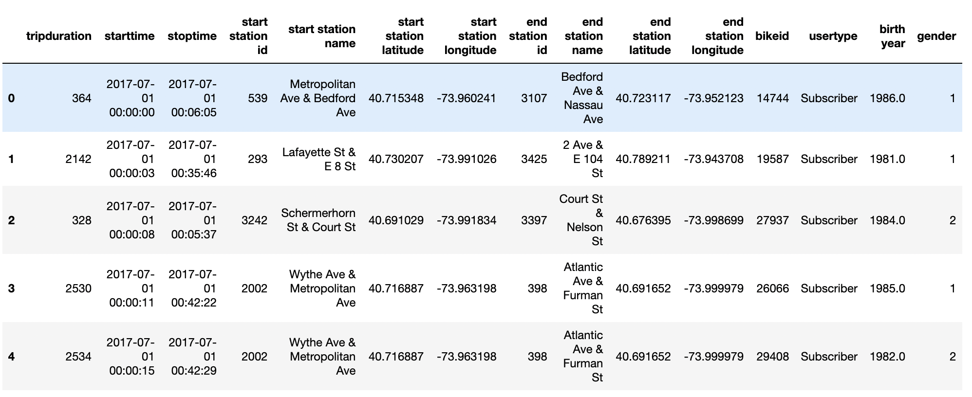
The dataset

Slide 5

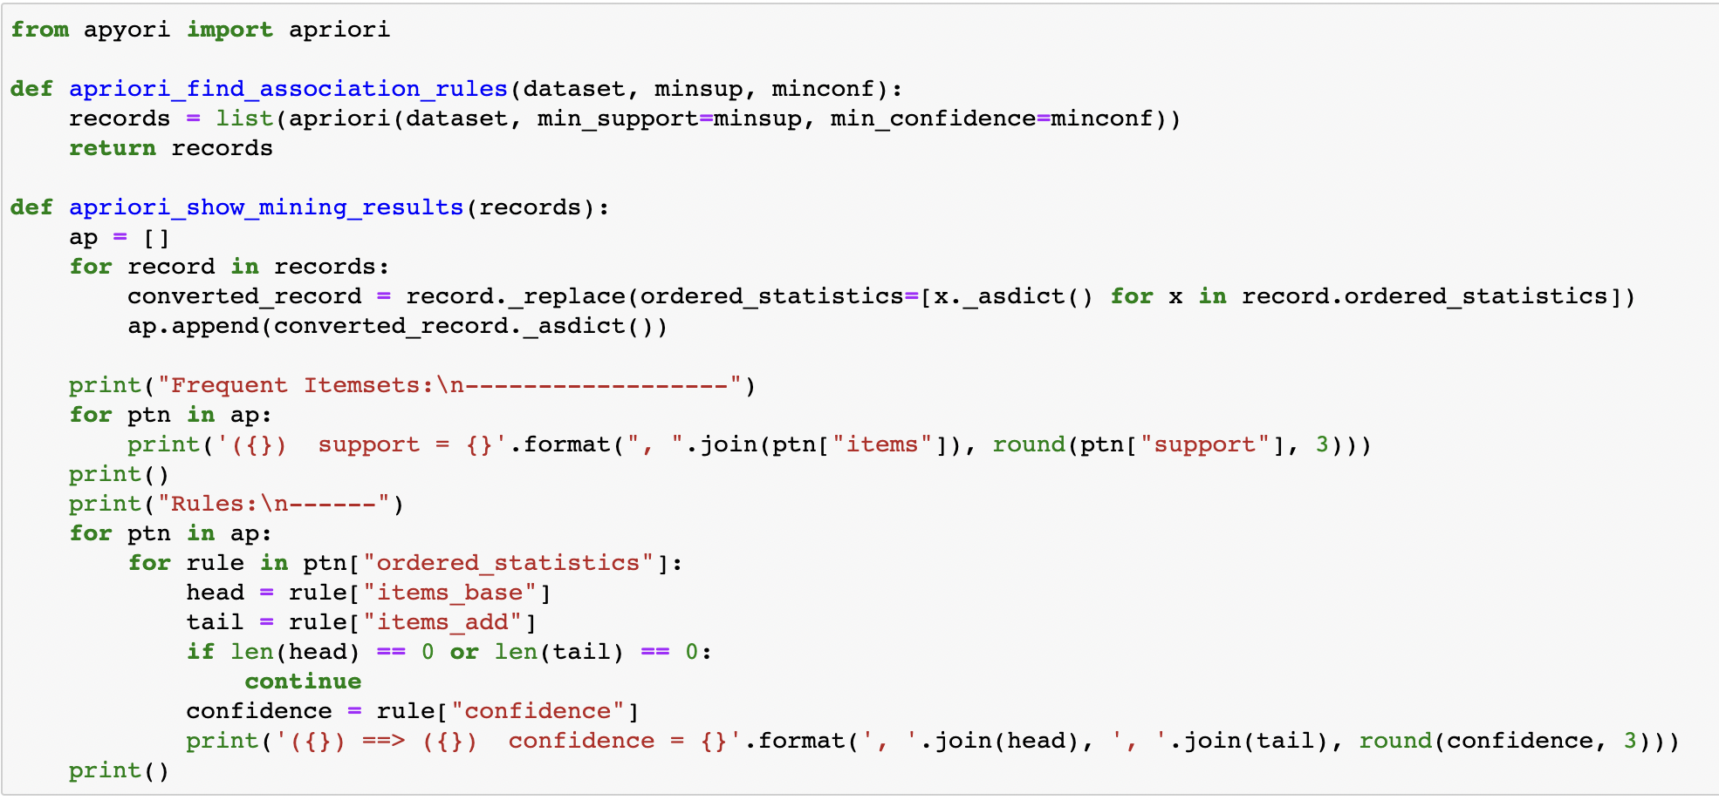
Association Mining – Apriori Algorithm
Justification:
Discover Hidden Patterns: Association rule mining is a powerful technique for uncovering hidden patterns and relationships within large datasets. In the context of CITI bike data, it can help identify interesting and potentially non-obvious associations between various factors, such as in-flow and out-flow, time of day, station locations, and daily flows.

Slide 6
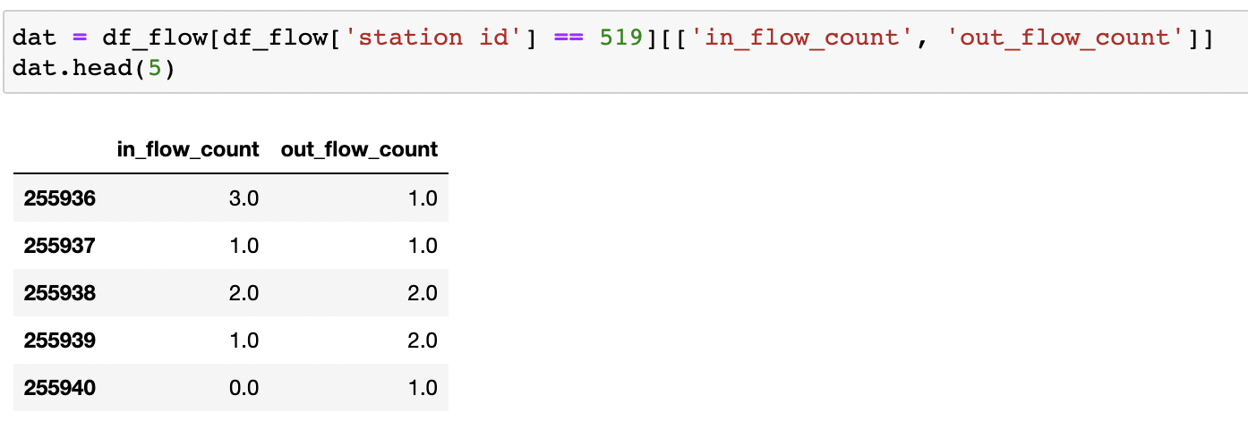
Data Frame for In-Flow and Out-Flow

Slide 7
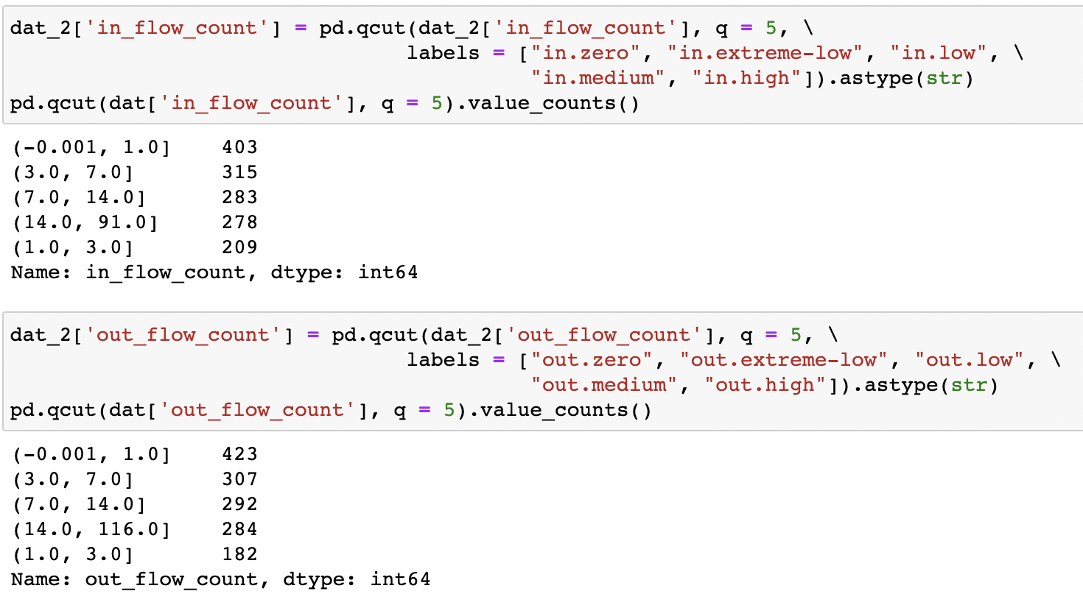
Find rules between In-Flow and Out-Flow of Station 519
We have descritized the In-flow and Out-flow data into 5 bins (zero", "extreme-low", "low", "medium", "high”)

Slide 8
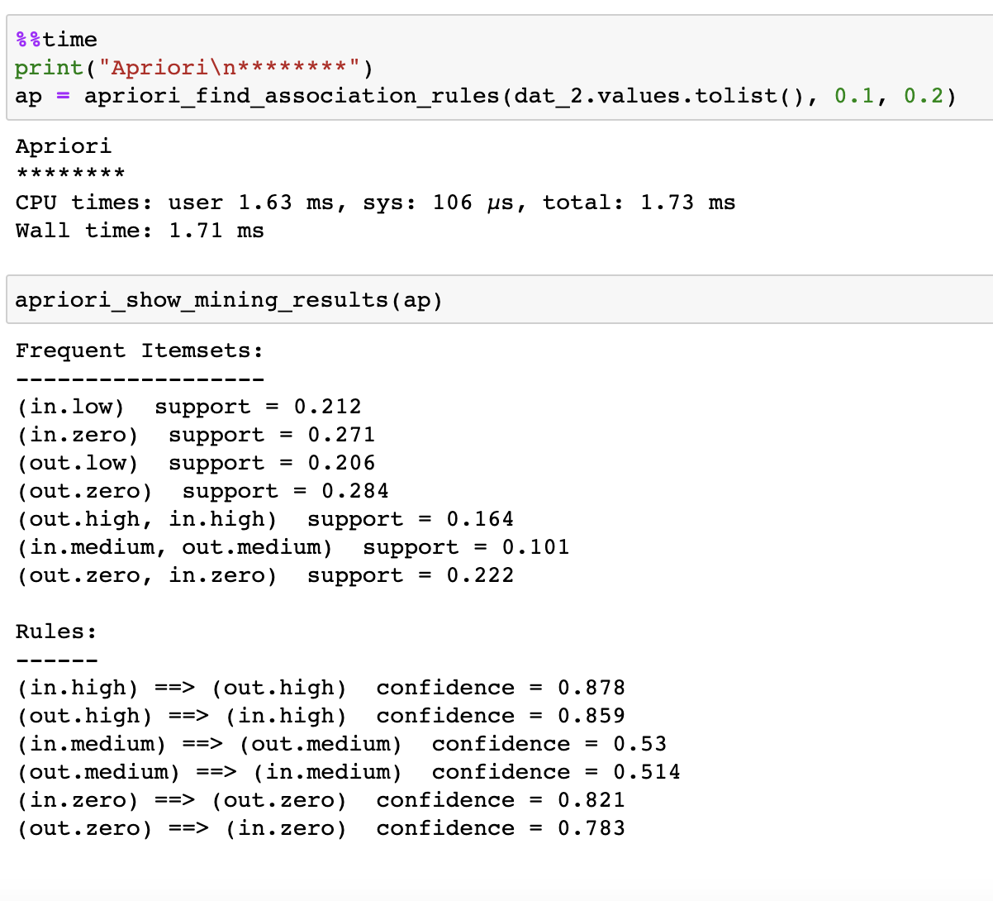
Association Rule Mining
High In-flow indicates high out-flow and vice versa. (confidence > 85%)
In-flow count of 0 indicates out-flow count of 0, and vice versa. (confidence > 78%)
Medium In-flow indicates medium out-flow and vice versa. (confidence > 50%)

Slide 9
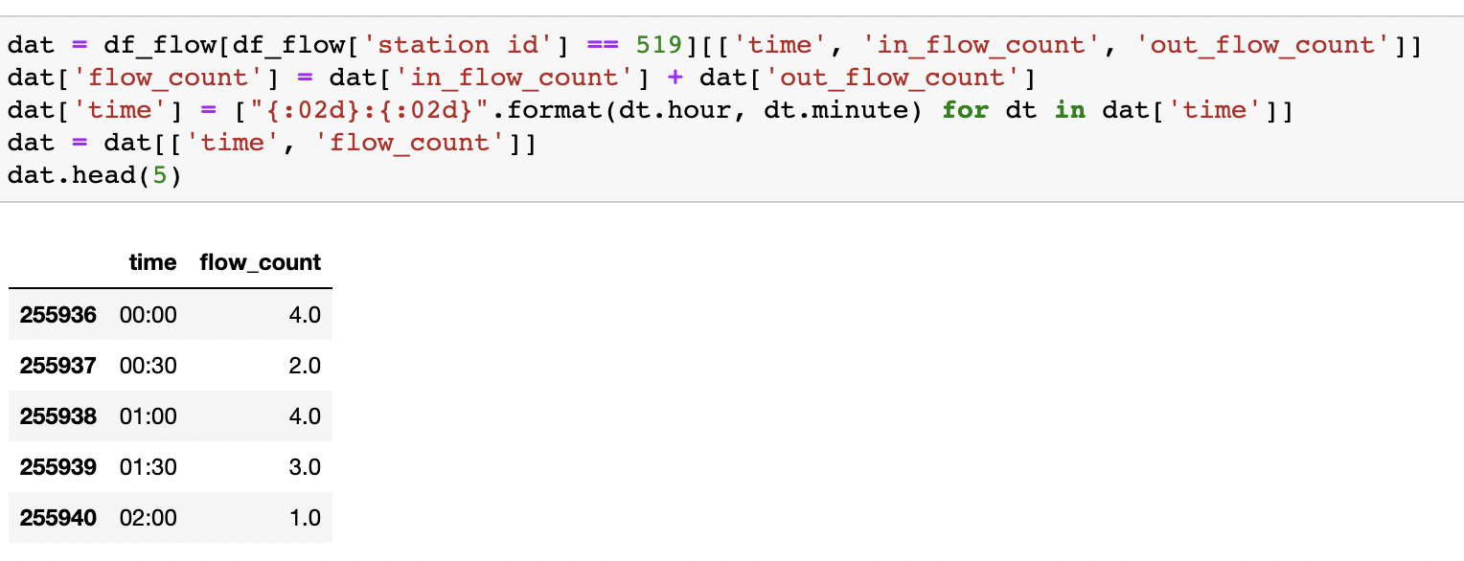
Data Frame for Time of a Day and Flows of station

Slide 10
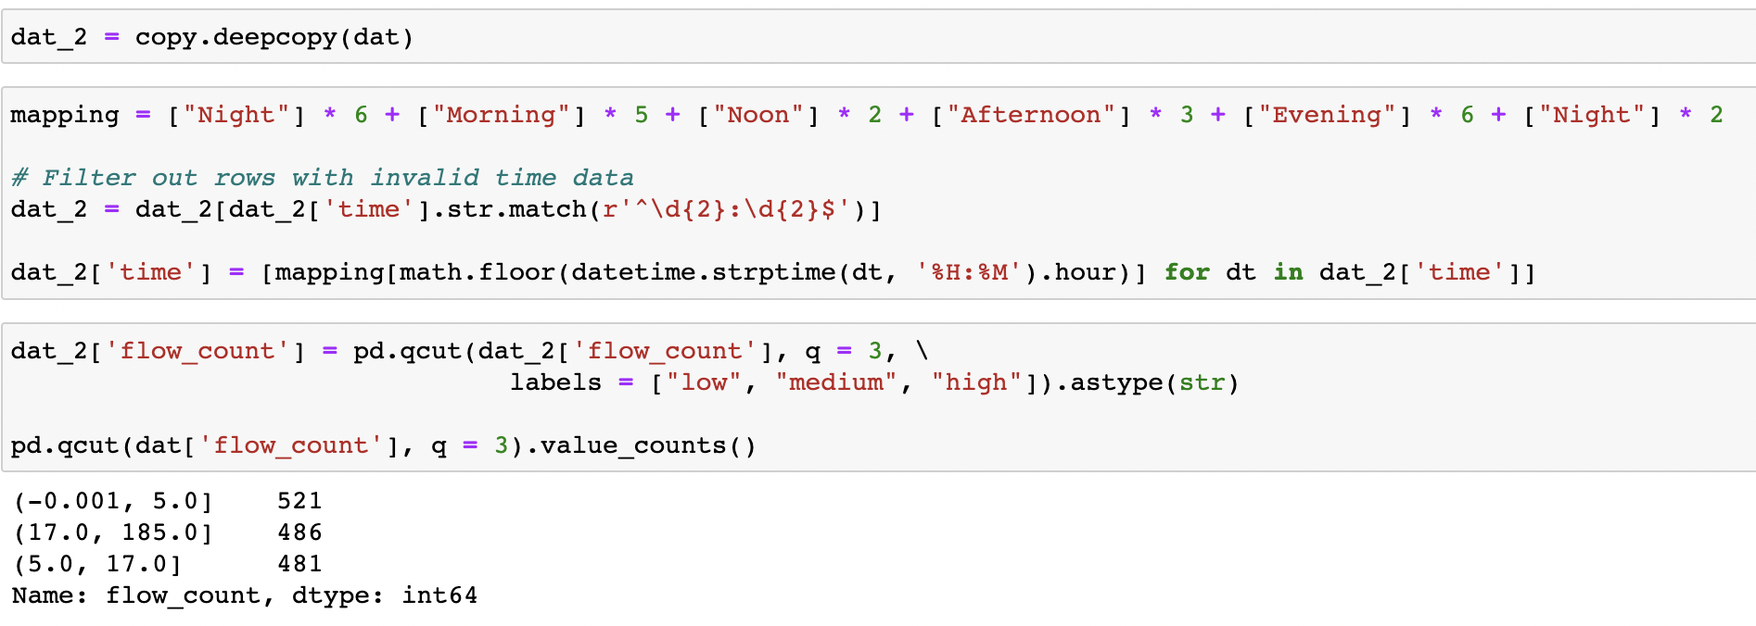
Find rules between Time of a Day and Flows of station 519
We have descritized the Flow of Stations into 3 bins ("low", "medium", "high”)
Split the Time of the Day into 5 intervals (“Night”, “Morning”, “Noon”, “Afternoon”, ”Evening”)

Slide 11
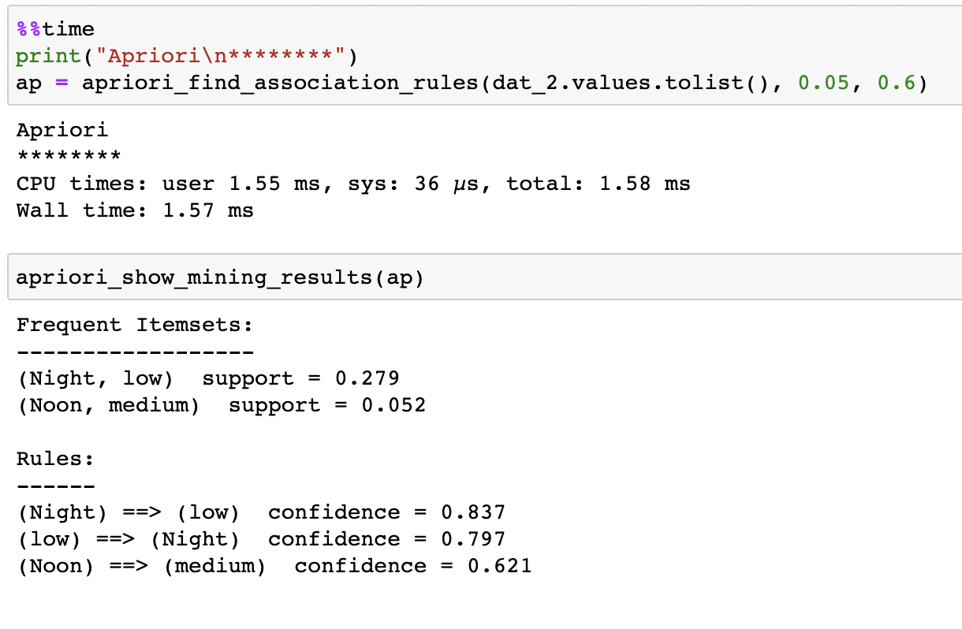
Association Rule Mining
At night, the flow counts tend to be low and vice versa. (confidence > 79%)
At noon, the flow counts tend to be medium. (confidence > 60%)

Slide 12
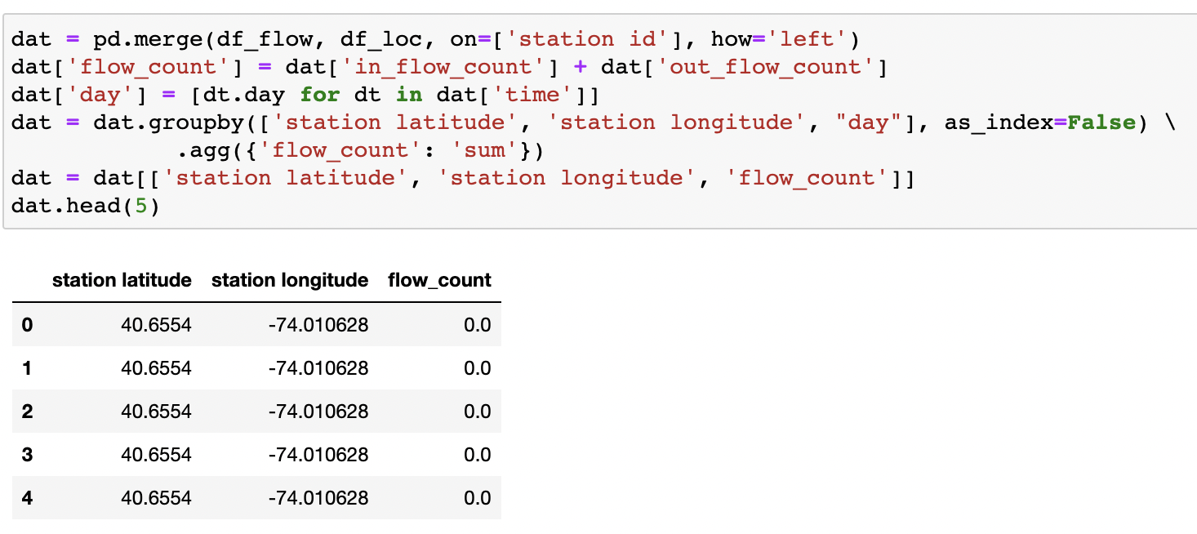
Data Frame for Station Locations and Their Daily Flows

Slide 13
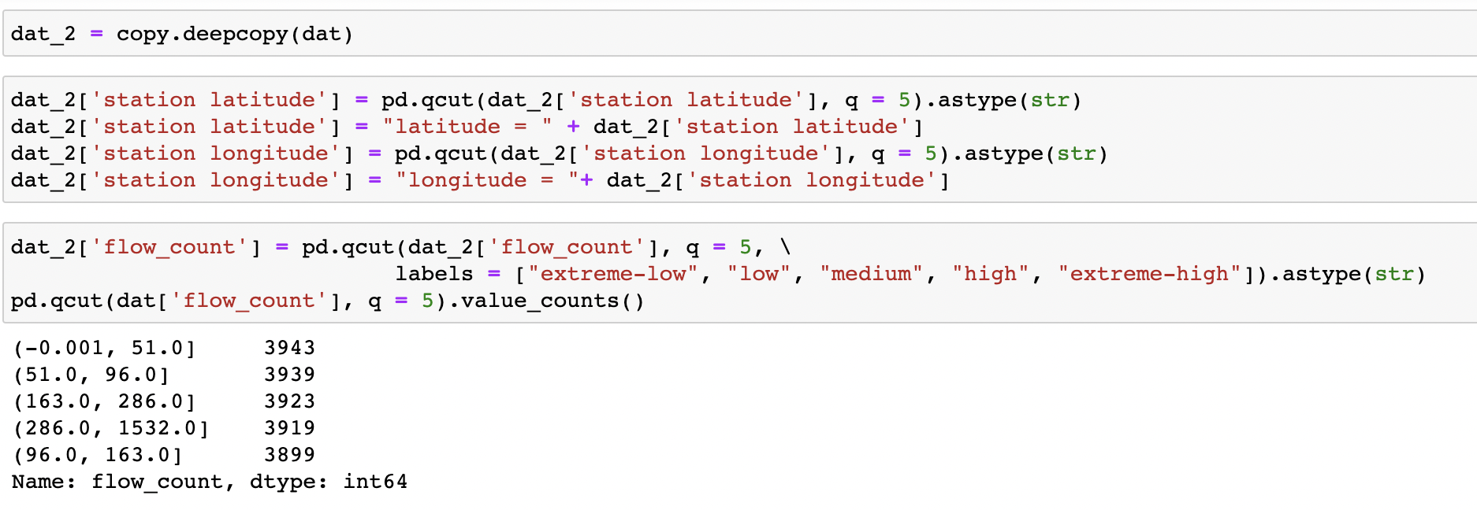
Find rules between Station Locations and their Daily flow 519
We have descritized the Daily Flow into 5 bins (extreme-low, low, medium, high, and extreme-high )
Split the Locations into 5 intervals.

Slide 14
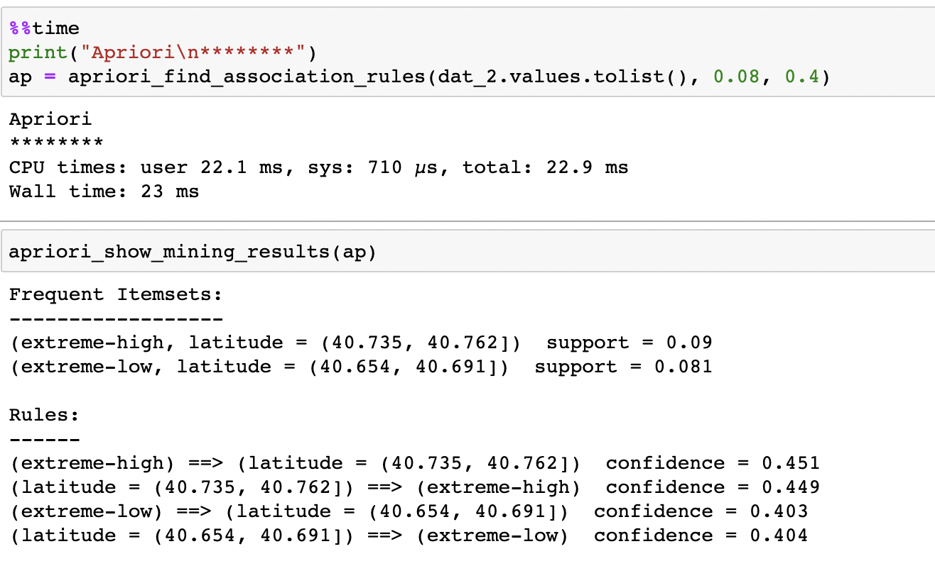
Association Rule Mining
Stations at latitude 40.736 ~ 40.762 tend to have extreme-high daily flow count. (confidence ≃≃45%)
Stations at latitude 40.654 ~ 40.691 tend to have extreme-low daily flow count. (confidence >40%)

Slide 15
Conclusions
High In-flow indicates high out-flow and vice versa. (confidence > 85%)
In-flow count of 0 indicates out-flow count of 0, and vice versa. (confidence > 78%)
Medium In-flow indicates medium out-flow and vice versa. (confidence > 50%)
At night, the flow counts tend to be low and vice versa. (confidence > 79%)
At noon, the flow counts tend to be medium. (confidence > 60%)
Stations at latitude 40.736 ~ 40.762 tend to have extreme-high daily flow count. (confidence ≃≃45%)
Stations at latitude 40.654 ~ 40.691 tend to have extreme-low daily flow count. (confidence >40%)

Slide 16
References
DataSet: https://www.kaggle.com/
https://stackabuse.com/association-rule-mining-via-apriori-algorithm-in-python/
https://learn.microsoft.com/en-us/analysis-services/data-mining/discretization-methods-data-mining?view=asallproducts-allversions

